Slide 1
Chapter 19
Using RMAN and Enterprise Manager

Slide 2
Background
None of the authors use EM in production environments for B&R
However, the GUI/BUI interface is fairly easy to use
Many people new to Oracle and RMAN will most likely want to try EM for B&R

Slide 3
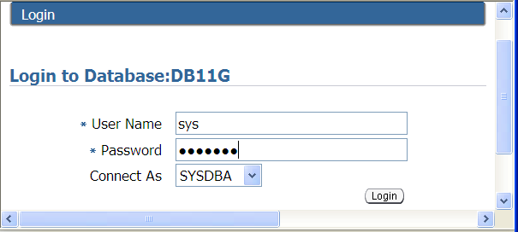
Using Data Recovery Advisor and Enterprise Manager
Logon with a schema that has sysdba privileges

Slide 4
Using EM Configuration Assistant
emca –config dbcontrol db –repos create
emca –deconfig dbcontrol db –repos drop
emac –config dbcontrol db –repos create –backup
emca -help

Slide 5
OS Credentialed User
RMAN needs to use an OS credentialed user
On Windows must belong to DBA group and must be able to run batch jobs
On Unix is usually the operating system user that was used to install the Oracle binaries

Slide 6
Creating a Backup
Navigate to availability screen
Enter host credentials
Choose backup options
Determine location of backups
Schedule backup time
Review RMAN backup scripts
Review status of backup job

Slide 7
Restoring and Recovering
Log In to EM and navigate to recovery screen
Choose objects to recover
Determine where to restore datafiles
Review RMAN commands
Run restore and recovery script
Review status of restore and recovery
Open database

Slide 8
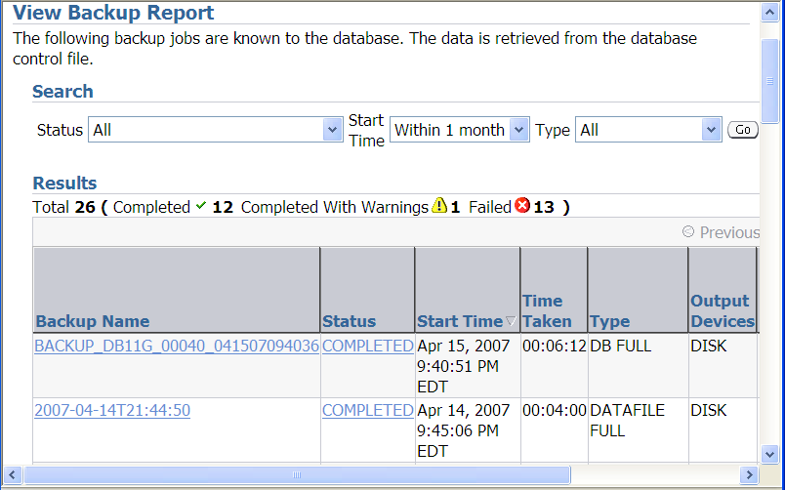
Viewing Backup Reports
Navigate to Backup Reports

Slide 9
Performing Routine Maintenance
Navigate to Manage Current Backups
Cross checking files
Deleting obsolete and expired files
Changing status of backups
Validating backup sets
Cataloging files

Slide 10
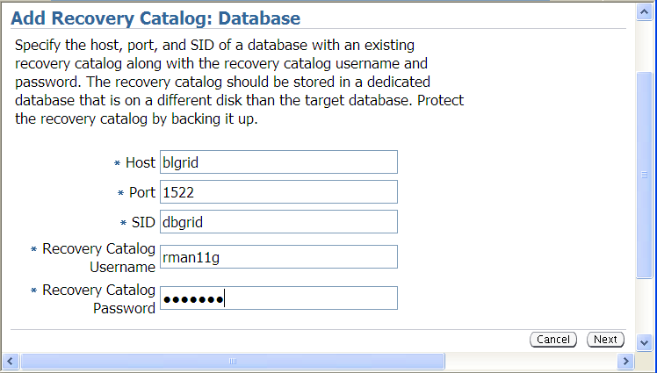
Configuring Recovery Catalog
Navigate to Recovery Catalog Settings
Add recovery catalog

Slide 11
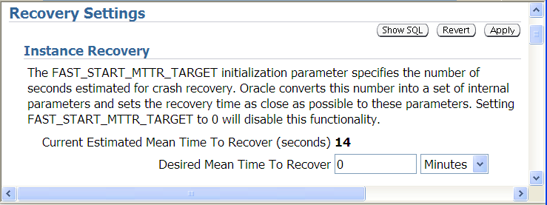
Configuring Instance Recovery
Navigate to Backup and Recovery
Navigate to Recovery Settings

Slide 12
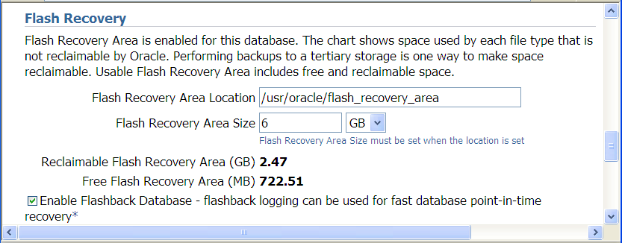
Configuring Flash Recovery Area
Navigate to Recovery Settings

Slide 13
Configuring Restore Points
Navigate to Manage Restore Points
Restore point is a pointer to an SCN
Must be logged onto EM with sysdba privileges to create restore points

Slide 14
Running Custom RMAN Scripts
Navigate to Job Activity screen
Create the RMAN script job
Create the RMAN script
Enter your credentials
Schedule the job

Slide 15
Configuring Backup Polices
Backup control file and spfile automatically
Not backing up files that haven’t changed since previous backup
Enabling block change tracking
Excluding tablespaces from backups
Establishing retention polices

